Slide 1


Slide 2
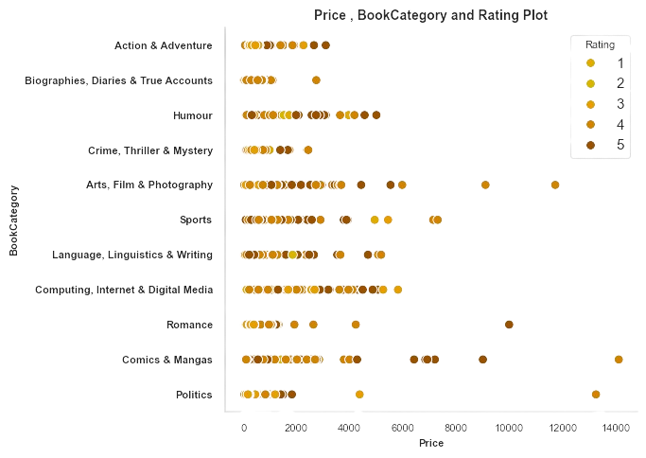

Data Source Details
5500+ Books
3600+ Authors
Book Editions 1973-2020
Ratings out of 5
Reviews by Customer [0-100]
Genre ~ Category 10

Slide 3
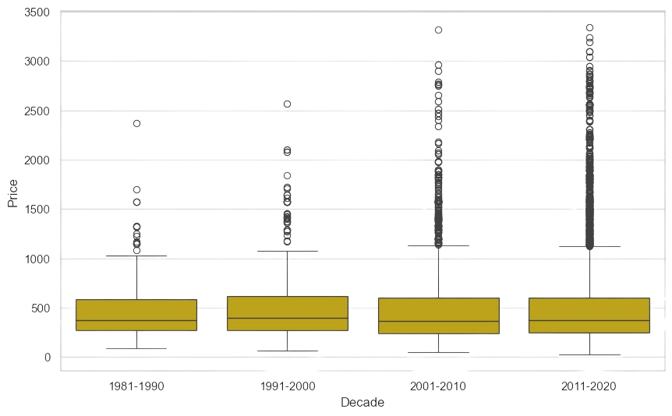
Objective and Metrics
Predict the Book Price (current)
Baseline ML Modeling
Identify , What Impacts the prize most
Data Available
Text Available
Metrics : The Root Mean Squared Logarithmic Error (RMSLE)
Score = 1- RMSLE
[Top 5 Score >80]

Slide 4
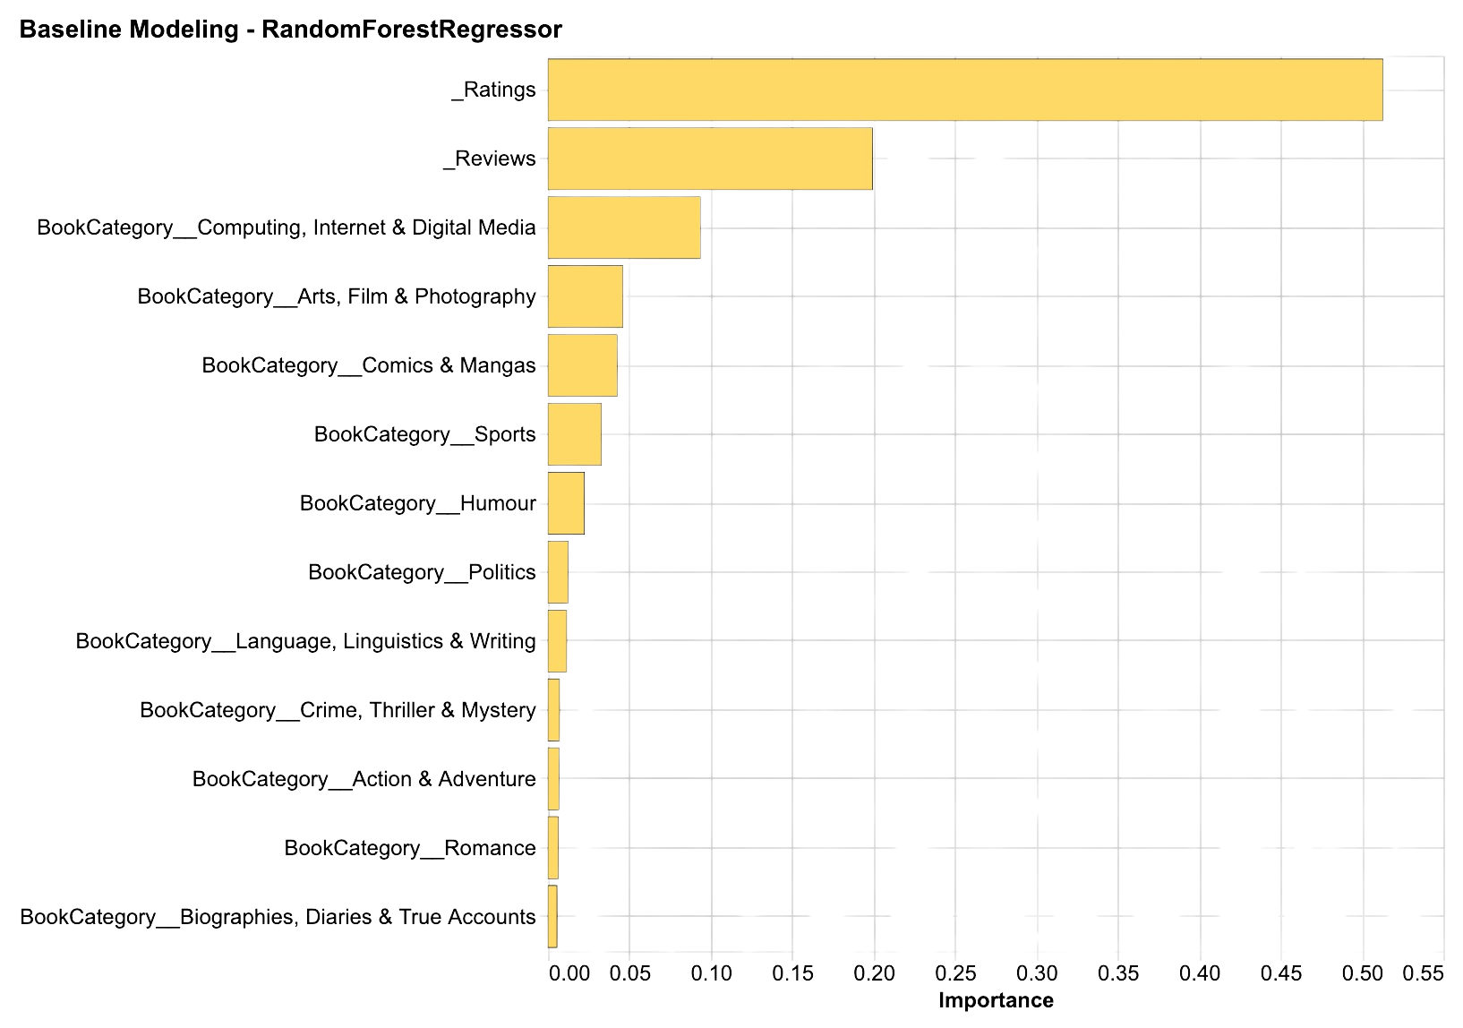
Am I feeling lucky ? Baseline Score
Random Forest feature Importance
Baseline ML Modeling
Minimum Features Transformation
44
RMSLE=0.55

Slide 5
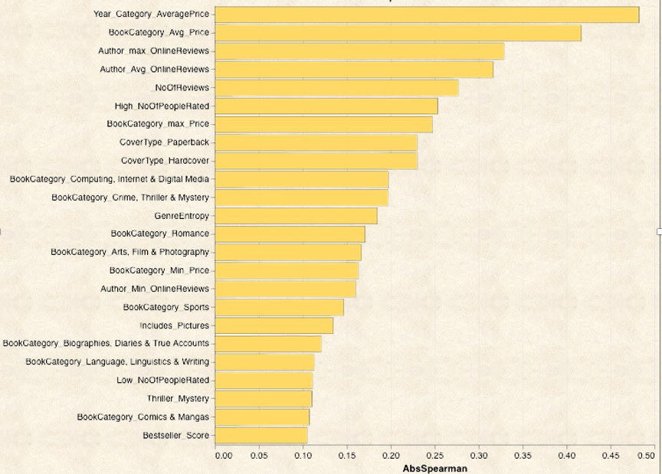
New Features Engineering and Correlation
Category Based Average Price
Category based Edition year prices
Category Based Ratings
Author Rating and Review
Book Cover Types – HardCover or Paperback
Sentiment on popularity
Are movies Part of Series
Thriller and Mystery have their takers
Historic Books
Entropy Based feats
Time of Book release
Entropy Author-genre Based feature

Slide 6
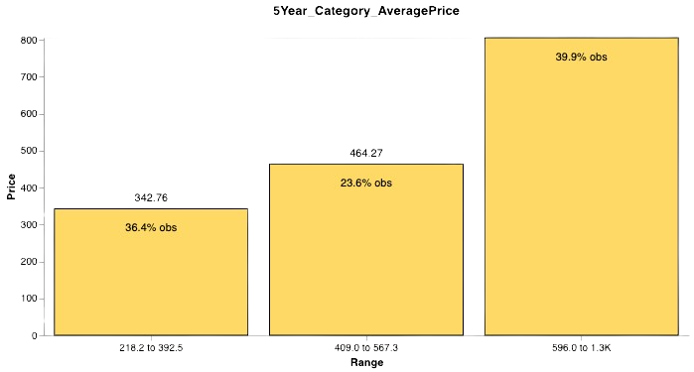
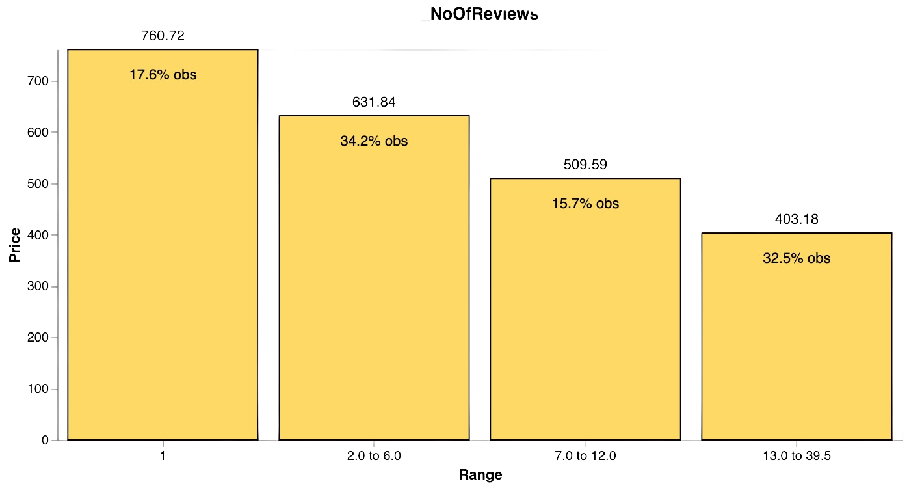
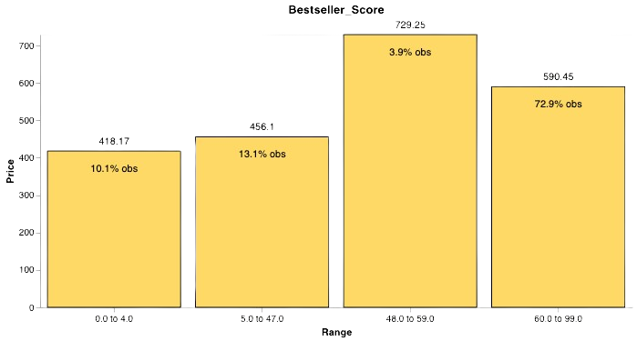
Tree- Based Bivariate
The following 3 variable show good relation to the Target
“No of Reviews” show negative relation with target , where as “5 years Average price for Book category” show clear positive relation whereas bestseller show mixed relation with price

Slide 7
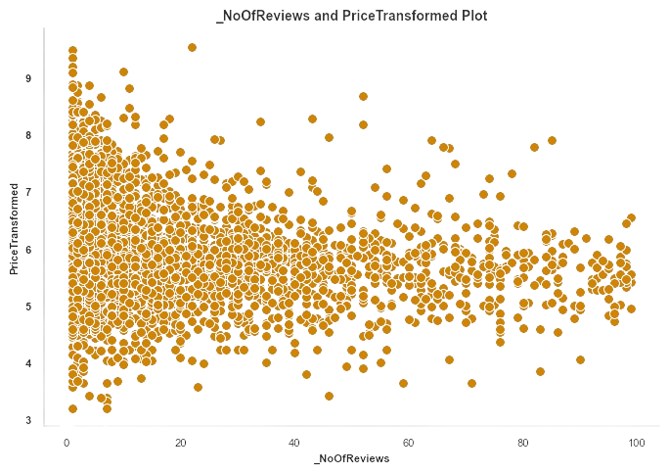
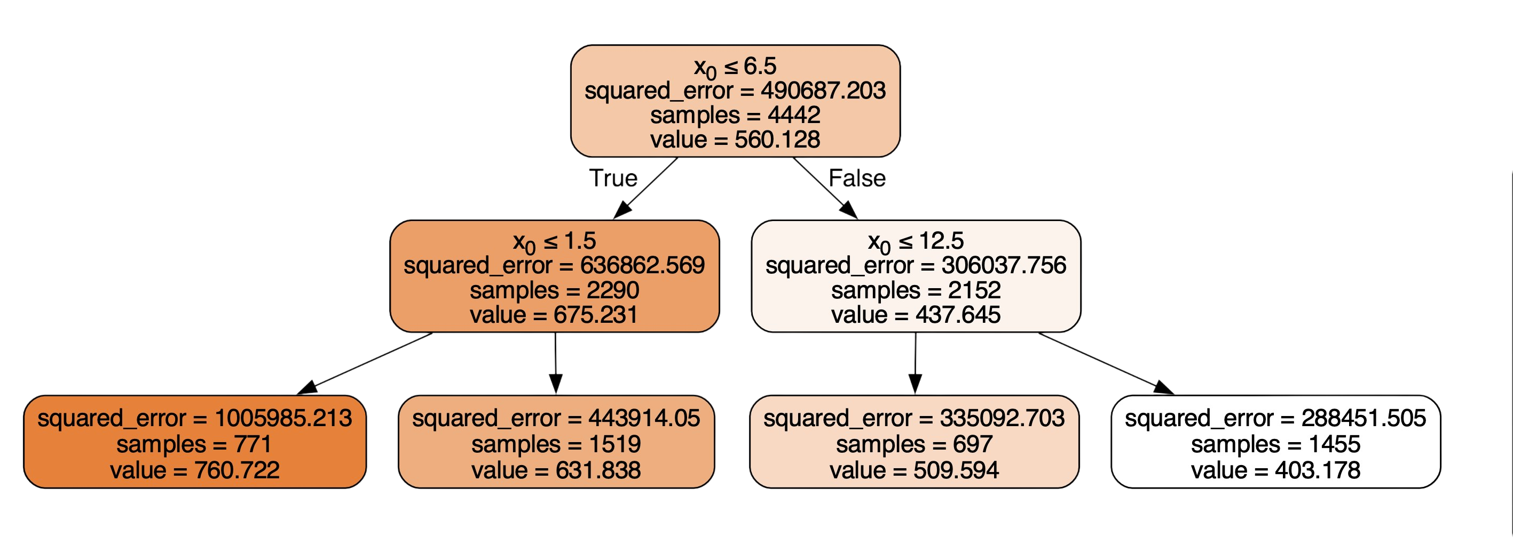
Tree(of Debth 2) : No of reviews
Review Count Impact:
X (number of reviews) significantly influences book prices (Y).
Lower review counts (0≤6.5X≤6.5) predict a lower price (560.128), while higher review counts predict a higher price (760.722).
Refinement with Additional Reviews:
For books with more reviews, further predictions are based on 0≤1.50≤1.5.
Fewer additional reviews predict a lower price (631.838), while more additional reviews predict a higher price (675.231).
Intermediate Counts and Prices:
Intermediate review counts (1.5<�≤6.51.5<X≤6.5 and 6.5<0≤12.56.5<X≤12.5) contribute to price predictions.
Specific review count ranges within these intervals predict distinct prices (631.838, 509.594).

Slide 8

Lets dig the synopsis
"FROM THE BESTSELLING AUTHOR OF RONALDO AND NEYMAR Prolific, cool-headed and unerringly consistent, Lionel Messi is one of the most revered footballers in history. But did you know that his transfer to Barcelona was first agreed on a paper napkin? Or that an x-ray of his hand was to thank for identifying his growth hormone deficiency? And do you know why he refused to collect his first ever Champions League winner's medal? Find out all this and more in Luca Caioli's classic portrait of a footballing icon, featuring exclusive interviews with those who know him best and even Messi himself. Includes all the action from the 2017/18 season and the 2018 World Cup"
SentimentIntensity Analyzer
(Valence Aware Dictionary and Entiment Reasoner)
Bestseller_Score
Word Tokenize
Thriller_Mystery
Historic
Part_of_Series
Includes_Pictures
Biography
TF - IDF Vectorizer

Slide 9

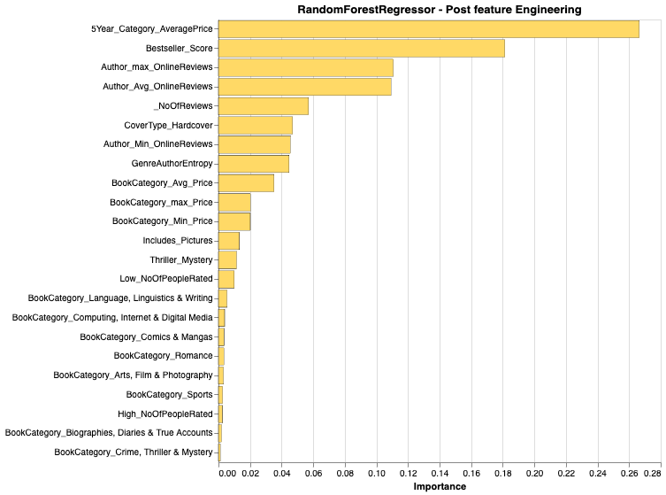
Model(Same) Again
Predict the Book Price but I changed the transformed the target to predict logarithmic target.
Applied Outlier handling using IQR method for certain price and reviews related attributes
Added a few text indication attributes
Eliminating the ones which are highly correlated to each other.
Metrics : The Root Mean Squared Logarithmic Error (RMSLE)
Removed variables with high missing and zero values.
Still No Hyperparameters adjustment , Except a depth of 5

Slide 10
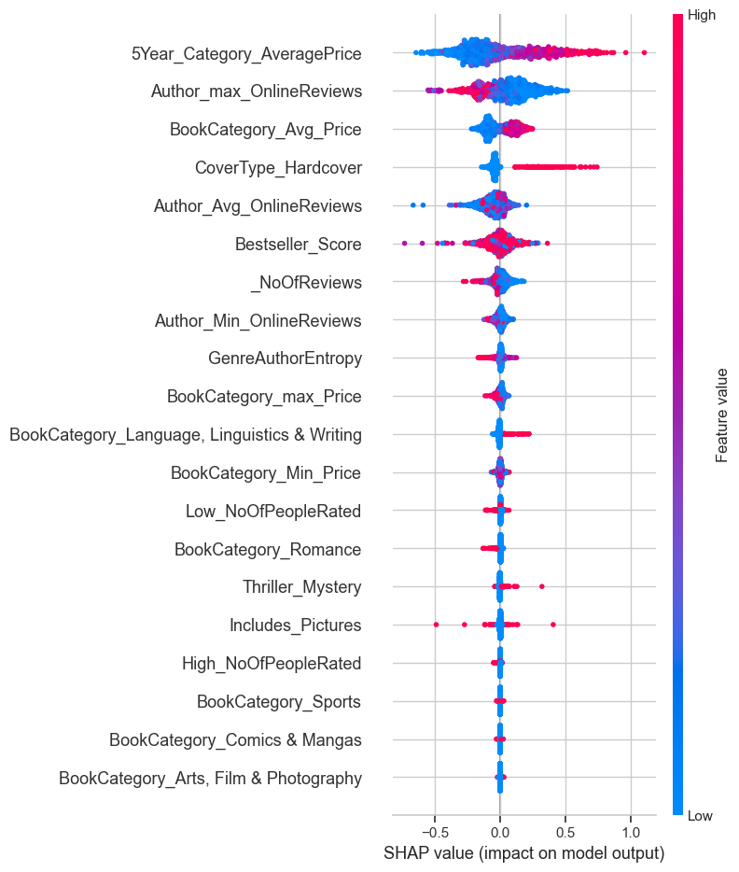
Model Explainer

Slide 11
Results Reveal and Questions
73%

Slide 12
Appendix

Slide 13
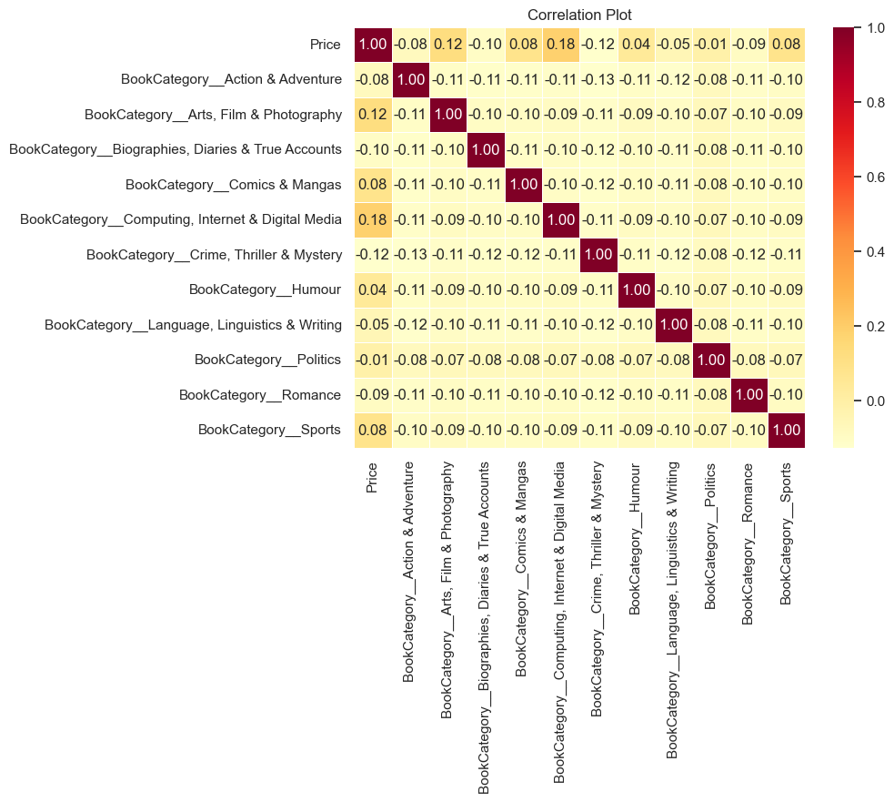
Model 1 Correlation

Slide 14
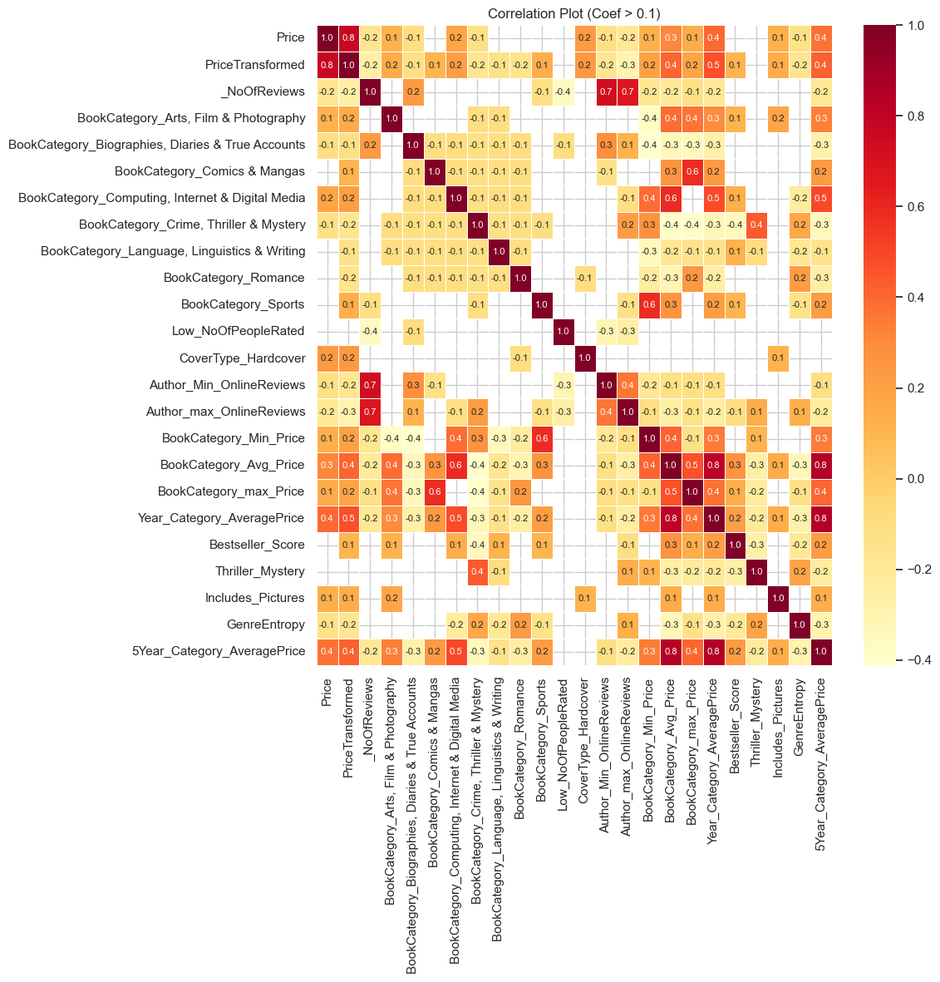

Slide 15
Entropy
In simple terms, the code calculates a measure called entropy for books based on their genre and author.
Entropy is a way to quantify the amount of uncertainty or disorder in a set of data.
CODE
def calculate_entropy(series):
counts = series.value_counts(normalize=True)
entropy = -np.sum(counts * np.log2(counts))
return entropy
entropy_by_Book_category = Modelready_df_v2.groupby(['Genre','Author'])['Price'].apply(calculate_entropy).reset_index()
entropy_by_Book_category.columns = ['Genre','Author', 'GenreAuthorEntropy']
entropy_by_Book_category
calculate_entropy function:
1. Calculates the relative frequency (normalized value counts) of each unique element in the series.
2. Computes the entropy using the formula: entropy=−∑��⋅log⁡2(��)entropy=−∑pi​⋅log2​(pi​), where ��pi​ is the probability of each unique element.
entropy_by_Book_category DataFrame:
Modelready_df_v2 by 'Genre' and 'Author'.
Applies the calculate_entropy function to the 'Price' column within each group.

